Slide 1
Final Project
Zachary Bergquist

Slide 2
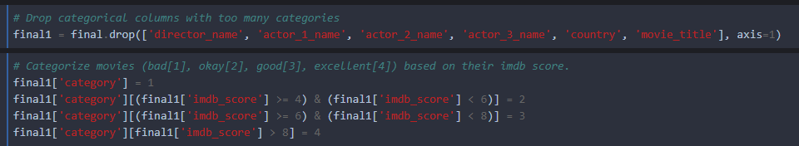
Categorization
First, I dropped the columns that have too many categorical values.
Next, I created categories for the movies based on their IMDb score. These four categories are Bad (<4), Okay (4-6), Good (6-8), and Excellent (8-10).

Slide 3
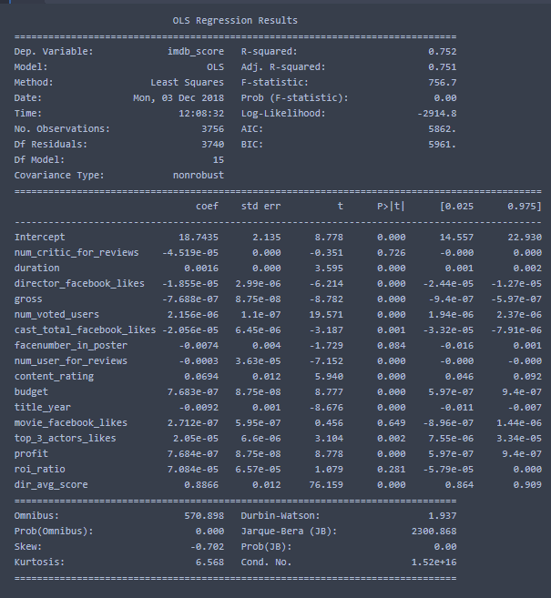
Regression
Simple Regression:
This model, including all variables, has an R^2 value of 0.752.

Slide 4
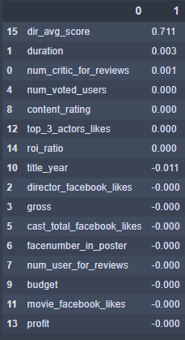
Lasso:
Starting from the top, the most significant variables found in the lasso model are director’s average score, duration, and number of critics for reviews. All other variables were considered insignificant.
The R^2 value of the lasso model is 0.734.

Slide 5
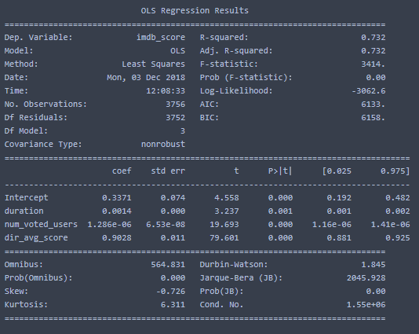
F Selection
The F Selection model used duration, number of users who voted, and the director’s average score to determine the best predictor. This is my preferred model, as it is based on overall popularity rather than critic popularity – more fair for the range of movies.
The R^2 value is 0.732.

Slide 6
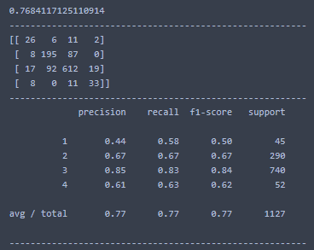
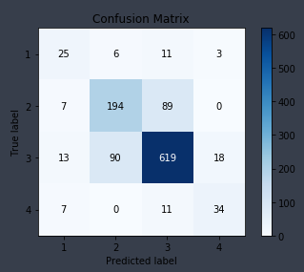
Decision Tree:
This model has an accuracy score of placing a movie in the correct category of 0.768, which is fairly high.
The confusion matrix shows that ‘good’ movies were most often correct.

Slide 7
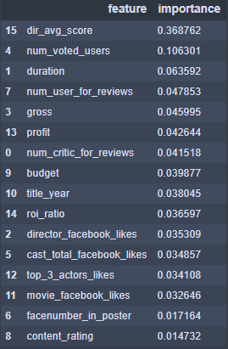
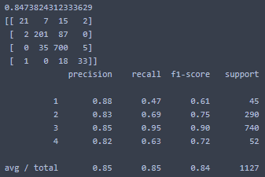
Random Forest
After 1000 iterations, this model has an accuracy of 0.847. It lists the most important variables as director’s average score, number of users who voted, and the duration of the film.

Slide 8
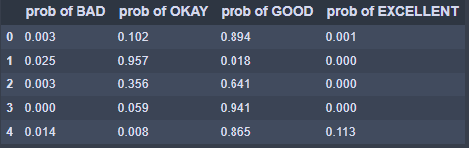
When divided by category, these are the results of correctly predicting the success of a movie.
As you can see, the probabilities are fairly high for each movie (only five movies’ results are shown).

Slide 9
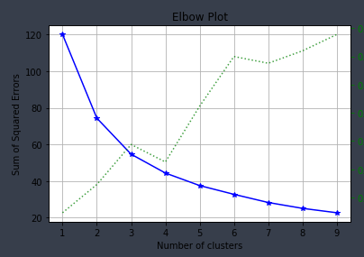
Clustering
This elbow plot shows that the ideal number of clusters is 4.

Slide 10
Conclusion
The 3 most important variables when predicting a movie’s success are:
Director’s average movie score
Amount of users who voted
Duration of the movie
Using this model, if you are a new moviemaker, it will be difficult to predict the score of your movie, as you have no previous history. If you consistently make high rated movies that are longer in duration and appeal to the masses, this model will be able to predict the success of your movie with relative accuracy.

